Slide 1
Digital Security IAM Services
Service Offerings

Slide 2
IAM Capability Overview

Slide 3





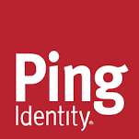

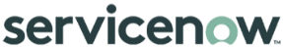


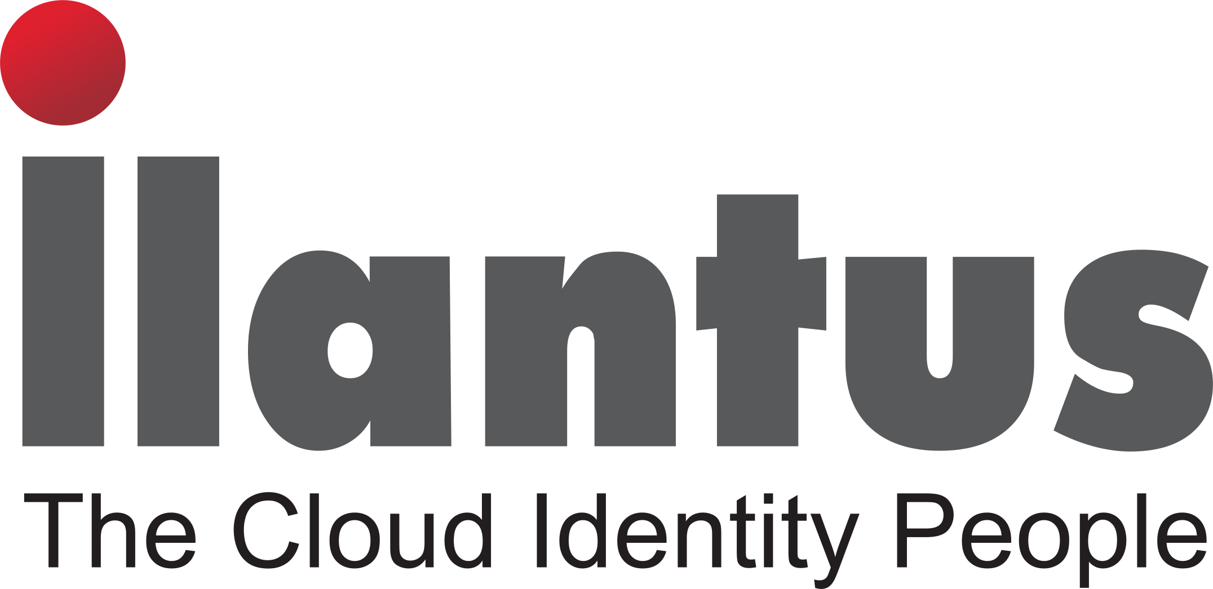
Digital Identity & Access Management – Service Offerings
IAM Consult
IAM Engineering
Managed Services
Architecture & Design
Deployment Services
Application Onboarding
Operations & Support
IGA
MFA
SSO
PAM
PIM
PKI
Analytics
Automation

Slide 4










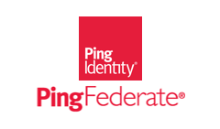





Digital Identity & Access Management –Key Technologies supported
Identity Management
Access Management
Privilege Management
Directory Services/LDAP
50+
IAM Engagements- Implementation & Operations
80 +
IAM technology professionals - 10 Certified Engineers
(Identity Management, Access management , CIAM and PIM/PAM)
20 +
Accelerators & Dashboards
4

Slide 5

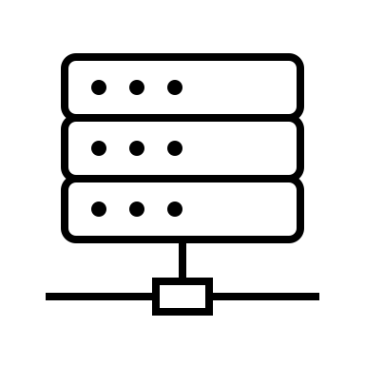
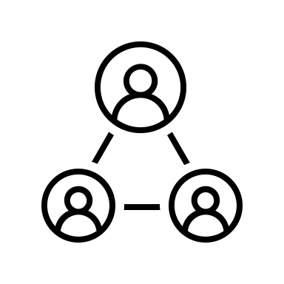
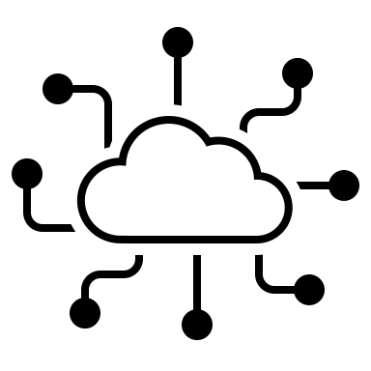


Unifying Identity & Access
Primary areas to consider for CIAM Transformation
Cloud
On Premise
Partners
Devices
Consumers / Customers
Directory Services
Partners / Affiliates
Identity Fabric
External IDs
Employees
Federation / APIs
Capabilities
Services
Technical Architecture
Identity API
Authentication
Directory Services
Legacy IAM
Digital Initiatives
Identity Federation
Access Governance
Identity Management
API
Privilege Access
Legacy Application
Access Management
Micro Services
SaaS Adoption
Identity Gov & Lifecycle
Auditing & Reporting
Access Governance
Cloud
On Premise
Legacy Integration
Policy
Standards
Connectors
Automation
Notes:
B2C Story: I have done similar migration for a customer where the userbase, like the one at ABG, was migrated from existing LDAP, to be precise, Tivoli Directory Server to Okta Universal Directory. The migration was to have more digital adaption, transforming legacy applications to new digital microservices architecture. The approach was initially taken to migrate existing customers to Okta using the Bulk Upload feature without migrating the passwords. Secondly, a custom login page was created to store the user password in Okta using JIT, for the first-time user logged in after migration. This custom authentication method ran for almost 2 years and then for the remaining set of users instructions were mailed to reset their password and finally legacy system was disconnected.

Slide 6
CIAM identity lifecycle framework
Integrate mobile channel for multifactor authentication and for transaction authorization
Eliminate aggressive timeouts for B2C users
Enable Push Notifications and SMS Alerting
Support for aggregation services, review password hashing mechanisms
Transaction limits on suspicious logins.
Monitoring of suspicious e-commerce purchases
Multichannel/device support
Capture Signatures electronically, use social media identities for guest registration
Consistent contact practices to reduce phishing susceptibility
Registration
User login
Session
Management
Account management
Credential management
Transaction
management
Privacy and Consent
Identity proofing
Enhanced
authentication
Session Management
Access administration
Credential composition
and storage
Transaction management
Consumer awareness (e.g.,
Right to be forgotten, right to access data)
Access provisioning
Progressive profiling
Credential change
Detect and respond to suspicious activity
Identify phishing and malware campaigns , fraudulent purchases through site analytics
Logging and monitoring
Notes:
Our CIAM identity lifecycle framework

Slide 7






COE IAM Reference Architecture with Zero Trust Enforcement & Architectural Principles
User Access Management
Identity management
Access Management
Privilege Identify and Access management
Manual Provisioning & De Provisiong
Provisioning
Password Mgmt
Single Sign-on
Password Vaulting
Employee
Reporting
Web Access Management
Access Requests
Risk Based Authentication
Secure Group and Role Provisioning
Reconciliation
Approval Workflow
Password Rotation
Strong Authentication
Identity Governance
Identity Federation
End Point Privilege Management
Mobile Users
User Profile Update
Fine-grained Access Control
Mobile and Social Access Management
Application Credential Management
Access Certification
Role Management
Multi Factor Authentication
Account Discovery
Zero Trust Enforcement
SoD Policies
Zero Trust Authentication
Partners
Least/Zero Privilege Enforcement
Multi-Factor Authentication
Directory Servers
LDAP
Active Directory
IAM Repository
(Identities, Policies, Rules)
Policy Enforcement
Endpoint Protection
User Stores
Consumers
Sample Enterprise Applications – On-Premise / Cloud
RHEL
AIX
Solaris
SaaS
Applications
Other Web & Non-Web Applications
Oracle HRMS
SOA – Webservices - ERP
IBM Lotus Notes
RACF
Application Repository
7

Slide 8












Identity and Access management for Employees, Partners and Customer
B2B & B2C
Integration
End to End Provisioning/
Deprovisioning
Roles and Groups Management
MFA and Conditional Access
Application
Onboarding
Privilege Identity Management
HR Feed Integration
Self-Service
Access Certification
Single Sign-On
Directory Services
Reports

